Slide 1
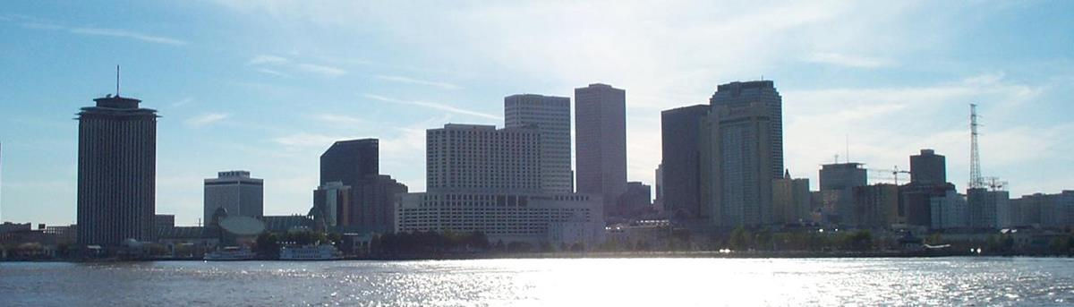
New Orleans
Applied Data Science Capstone: IBM Certification
By Christine Bello

Slide 2
Contents
Introduction
Methodology
Aesthetics
Affordability
Safe Environment
Goods and Services
Summary and Recommendations

Slide 3
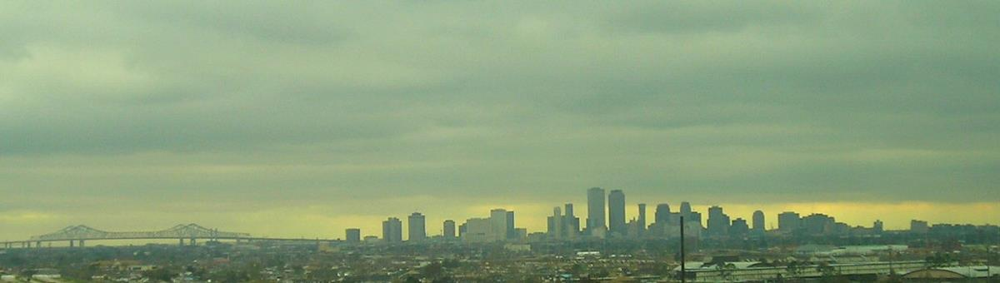
Introduction
Background:
In 2005 America's Big Easy was ravaged by a devastating act of nature. Hurricane Katrina stole the lives and livelihoods of many American citizens, and while there are no words to describe the devastation or heartache of the victims, the disaster brought communities and the American people together to respond and rebuild.
Since that time New Orleans has seen remarkable growth! While the population remains at 80% of what it was pre-Katrina, according to the Census Bureau in 2012, New Orleans ranked # 1 for population growth at 4.9%. Which is more than six times the national average.
According to the World Population Review:
"There's no doubt that Hurricane Katrina was a terrible disaster and tragedy, but it gave New Orleans the money and opportunity to rebuild and reinvent itself [...] If current trends hold, New Orleans should have no trouble making its way back to pre-Katrina levels and possibly beyond before the next census in 2020."
Justification/Interest:
The city is known for its rich culture and history, but during this period of regrowth has also embraced new technology, ideas, and businesses to drive population growth. Due to the renovations and investment into the area, New Orleans is a point of interest for individuals (stakeholders) looking to relocate.
Objective:
For individuals considering a move to the Big Easy, this presentation aims to provide district recommendations using information about demographics, economy, education, local venues and crime data.

Slide 4
Methodology
Define Stakeholder Interest
U.S. News States the Primary factors that influence a move are: Aesthetics, Affordability, Safe Environment, and Goods and Services Availability
Gather, Clean, Prepare Data
Public datasets for New Orleans can be found at datadriven.nola.gov, Wikipedia, and HomeSnacks
Analyze Data using GeoPandas and kCluster
Create DataFrames and use PivotTable Method to count offerings in each neighborhood.
Perform Cluster Analysis on acquired data from FourSquare
Visualize Data using Folium and Matplotlib
Evaluate Results and Make Recommendations
Notes:
Consider talking about:
Port
Business
Tourist and convention business
Other

Slide 5
Aesthetics
“An attractive neighborhood indicates the residents care about it.”
Data Used: Market Value Analysis Final Report 2018 available on www.data.nola.gov
Analysis: Based on % of New Construction.
Notes:
Consider talking about:
Beginnings
Native Americans and French Louisiana
Slavery in French Louisiana
Religion and architecture from across the world
Post-Treaty of Paris
United States territory
Battle of New Orleans
Port
Slavery and immigration
Civil War

Slide 6
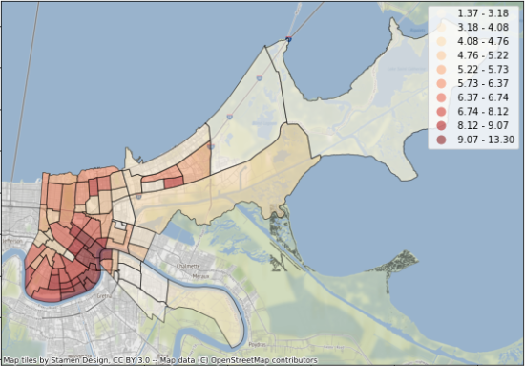
Analysis/Visualization
The neighborhood with the most new construction was Iberville with 13.3%. New construction can also be indicative of the damages sustained from Katrina and the areas that needed the most care. It’s clear by the choropleth map below that much of the lower central area of New Orleans has seen some repair or construction.
The top five areas were Iberville (13.3%), French Quarter (12.6%), Central Business District (11.1%), Lower Garden District (10.7%) and Algiers Point (10.3%).

Slide 7
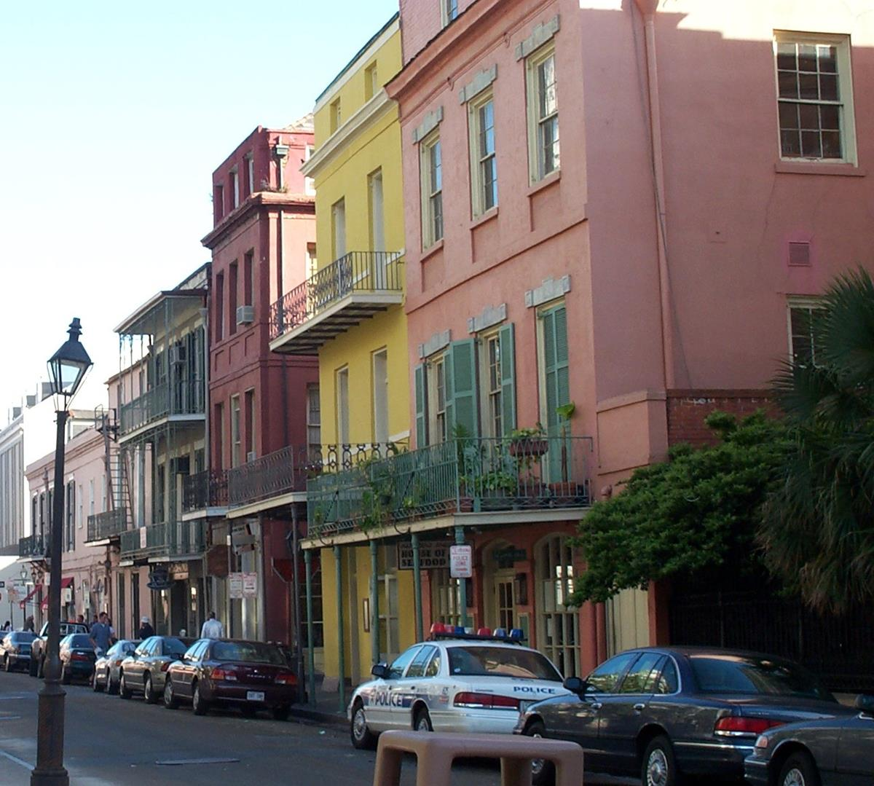
Affordability
“Sure, you want a cheap house, but you also want to be able to afford the cost of living in the neighborhood.”
Data Used: Market Value Analysis Final Report 2018 available on www.data.nola.gov and HomeSnacks.net
Analysis: Based on median Home Value per neighborhood.
Notes:
Consider talking about:
Elevation
Cityscape
Climate
Threat from tropical cyclones

Slide 8
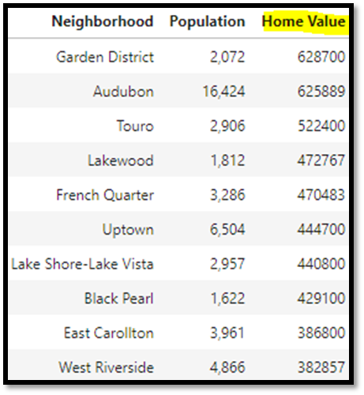
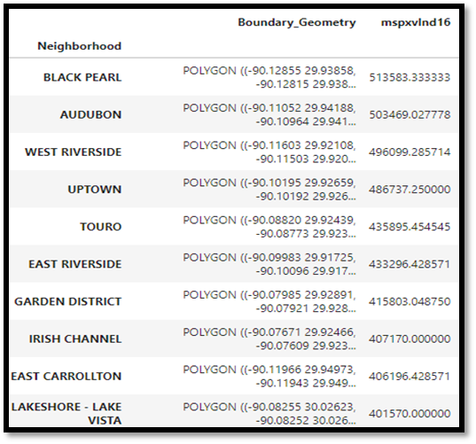
Analysis
Homesnacks
Market Value Analysis

Slide 9
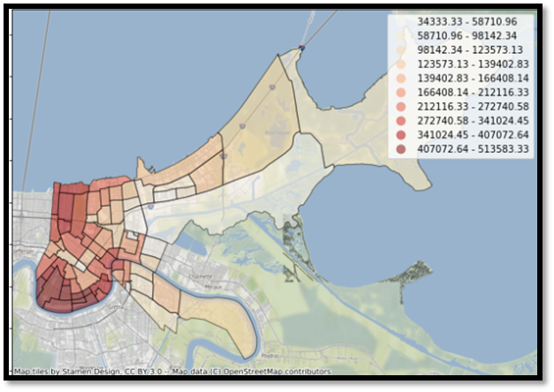
There was a lot of overlap between the two results. Which says that the more expensive areas have retained their value, but a lot can change in a couple of years. The data we scraped from Homesnacks is more recent and possibly more reliable. From that information we can also see that home value in New Orleans has increased all around. New Orleans is a major U.S. City so home value is going to be higher than the average in Louisiana.

Slide 10

Safe Environment
“Nobody wants a mugger or sex offender as a neighbor.”
Data Used: Hospital, Health Clinic, Drug Stores, Evacuspot and Calls for Service 2019 available on www.data.nola.gov
Analysis: Based on emergency services locations and calls for service locations.
Notes:
Consider talking about:
Tourism
Entertainment and performing arts
Food
Dialect
Voodoo
History and Origins

Slide 11
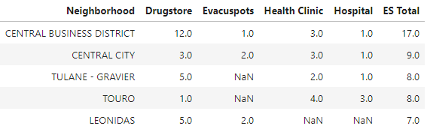
Emergency Services
The area offering the most emergency services was the Central Business District, followed by Central City, Tulane – Gravier, Touro, and Leonidas.

Slide 12
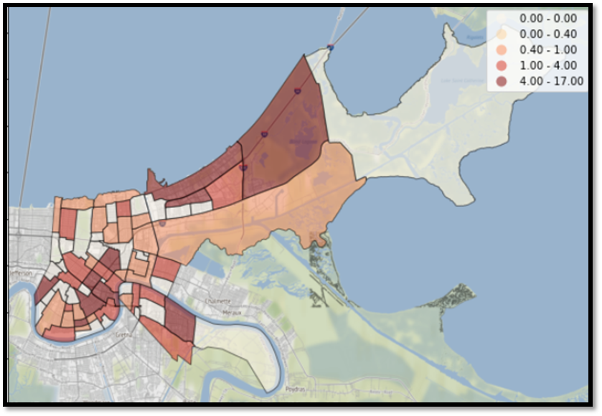
Affordability

Slide 13
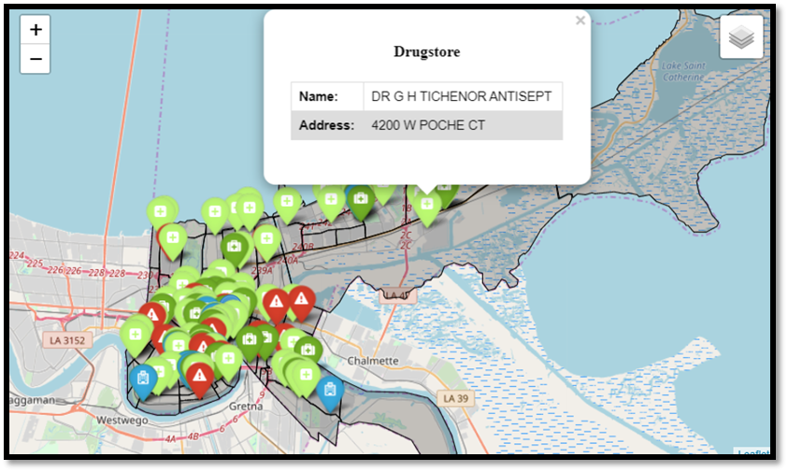
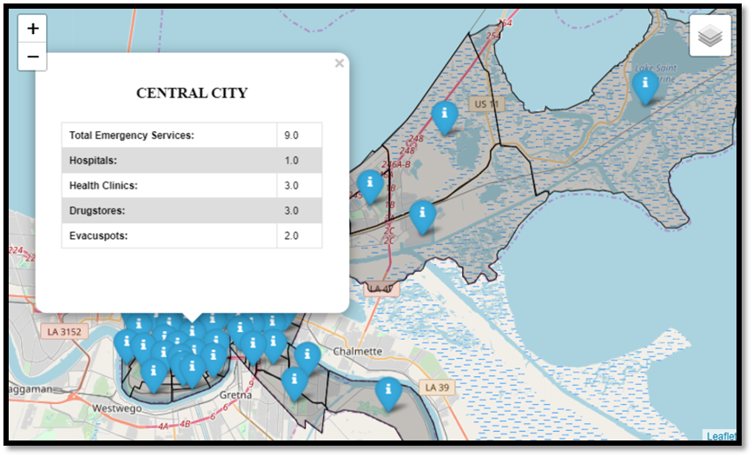
Additional es Maps
Markers with varied colors and icons indicate what kind of emergency service was available.
The 72 markers relating to each neighborhood display the totals for each subtype and an overall total for each neighborhood are displayed.
Various maps allow individual stakeholders to make decisions based upon their own values and needs in accordance to what they place importance upon

Slide 14
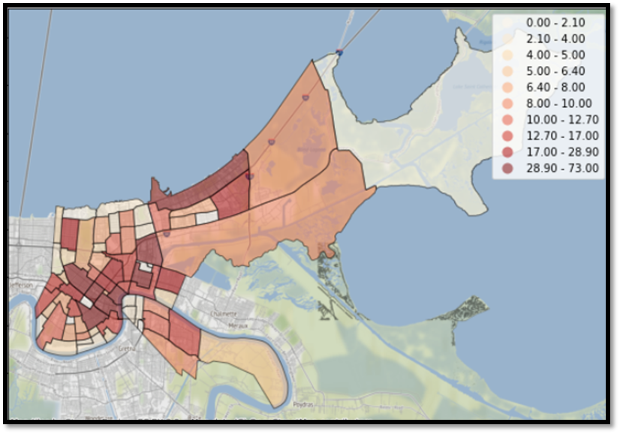
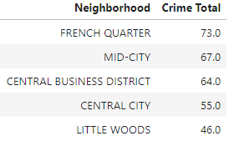
CRIME Profile
Not surprisingly the French Quarter boasts the most calls for service. While the Central Business District ranked #1 in our emergency services analysis, it also ranked pretty high in our crime analysis. It's probably that the Central Business District is a highly populated area, same as Central City. How did our other high ranking emergency services neighborhoods do?
Tulane - Gravier (31 calls)
Leonidas (15 calls)
Touro (9 calls)
Not bad. Though by aggregating the data we lose sight of what type of incident occurred. It's normal to see a higher incident rate where there are larger populations.

Slide 15
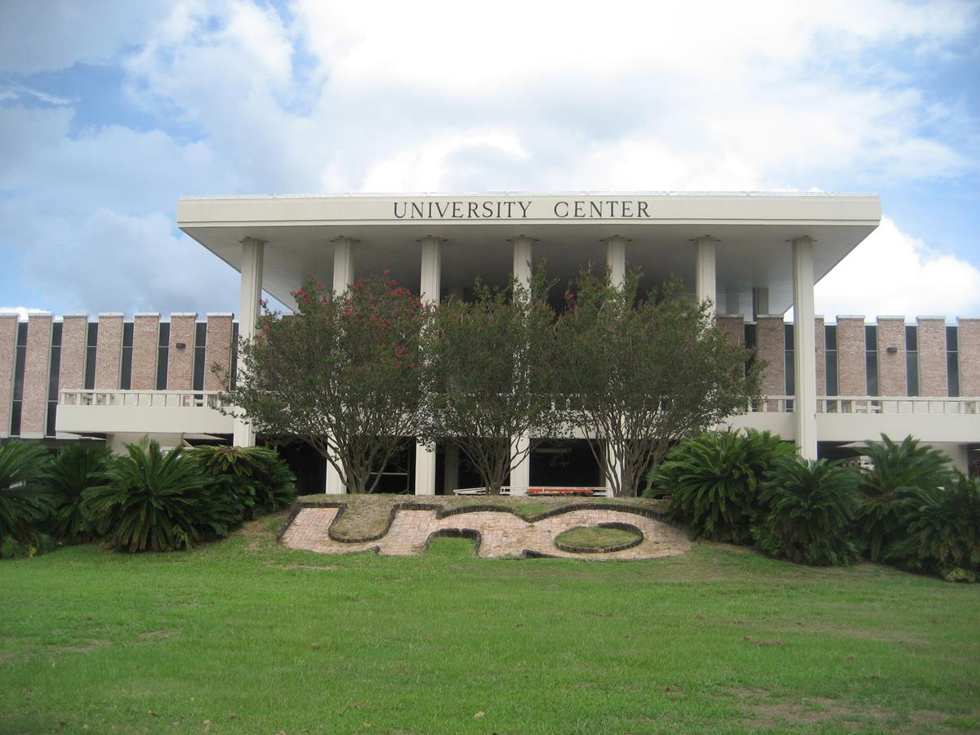
Goods and Services
“Can you make a quick run to the bank or grocery store, or will every day be a headache behind the wheel due to traffic congestion or construction? - Even better, ditch the car. If exercise and a sense of community are important to you, find a house near the establishments you'll be frequenting.”
Data Used: Residential, Hospitality and Shopping sets used are available on www.data.nola.gov FourSquare results were returned using the FourSquare API.
Analysis: Based on count of service type per area and cluster analysis for FourSquare.

Slide 16
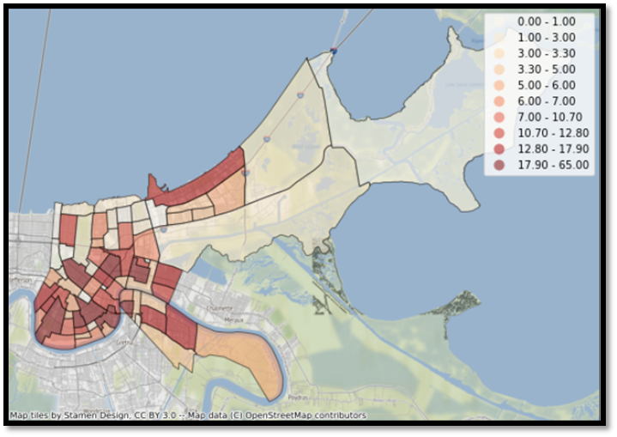
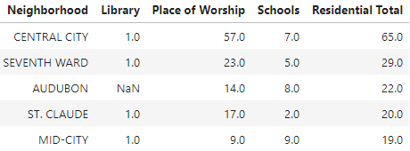
Residential
The neighborhood with the most “residential” offerings was Central City. There are double the amount of religious locations in Central city than any other place, but otherwise seem to line up with the average amount of Schools. I was surprised that Audubon did not have a library.

Slide 17
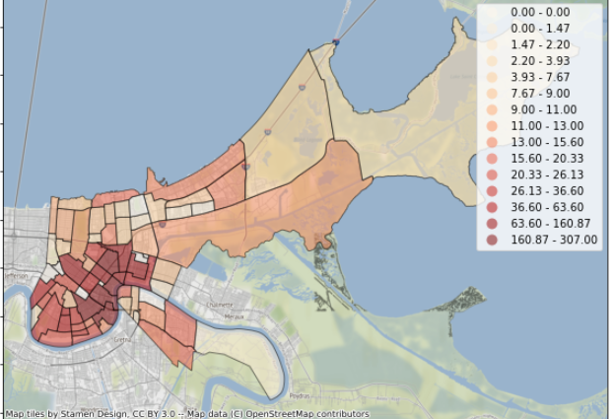
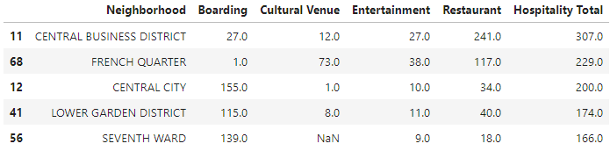
Hospitality
Unsurprisingly the neighborhoods with the most hospitality type goods and services (Boarding, Cultural Venues, Entertainment Venues, and Restaurants) are the tourist locations: CBD, French Quarter and Central City. The entire lower area in New Orleans is attractive to tourists and hosts a variety of festivals and entertainment throughout the year.

Slide 18
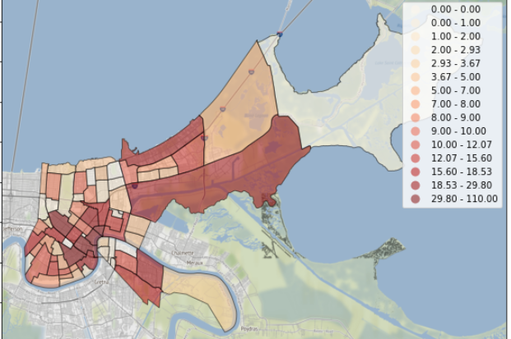
Shopping
The top five neighborhoods for shopping/business access are:
French Quarter (110)
Central Business District (102)
Mid-City (65)
Central City (63)
Marigny (32).

Slide 19
Foursquare
For all 72 neighborhoods there were 210 unique categories of venues. The Central Business District and French Quarter were the only two neighborhoods to hit the maximum of 100 venues. Marginy had quite a bit of venues as well (94).

Slide 20
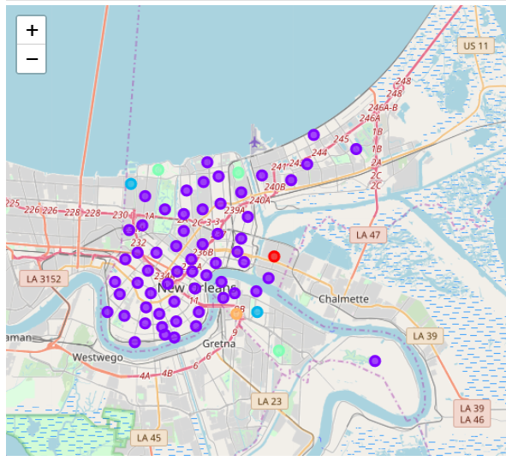
Cluster Map
Purple = Combination Residential/Hospitality/Business
Turquoise = Parks/Marina
Blue = Playgrounds
Red = Food
Orange = Nightclub

Slide 21
Discussion and recommendation
New Orleans is a bustling metropolis and popular tourist destination, but most every neighborhood has it’s own value proposition. While the more popular areas had more to offer in terms of hospitality and emergency services they also had more crime. There was an even spread of goods and services throughout the neighborhoods with exception to sparsely populated swamp areas.
Based upon the analysis and results I would look into the lower left to lower mid section of New Orleans

Slide 22
Summary and Conclusion
Aesthetics: Iberville
Affordability: The cheapest neighborhoods according to our data was Desire and Florida Dev, but that may be because there isn’t much data for those areas/the cost is for the land/smaller cabin homes. The Cheapest Neighborhood according to HomeSnacks website is Tall Timbers-Brechtel, however you get what you pay for. These homes sell for roughly $127k.
Safe Environment: The Central Business District offered the most emergency services, but that was largely due to the 12 drugstores available in the area. Touro actually boasts the most hospitals (3) and Health Clinics (4). There are no Evacuspots in Touro, though. As for Crime the areas with the lowest crime were Freret and Florida Dev. Accordingly the Garden District and Uptown have historically had a lower crime rate.
Goods and Services: The French Quarter and Central Business District have the most offerings.
In conclusion, the best neighborhood recommendation depends on the stakeholder’s values, but this report contains enough summary information to make an educated decision.

